Slide 1
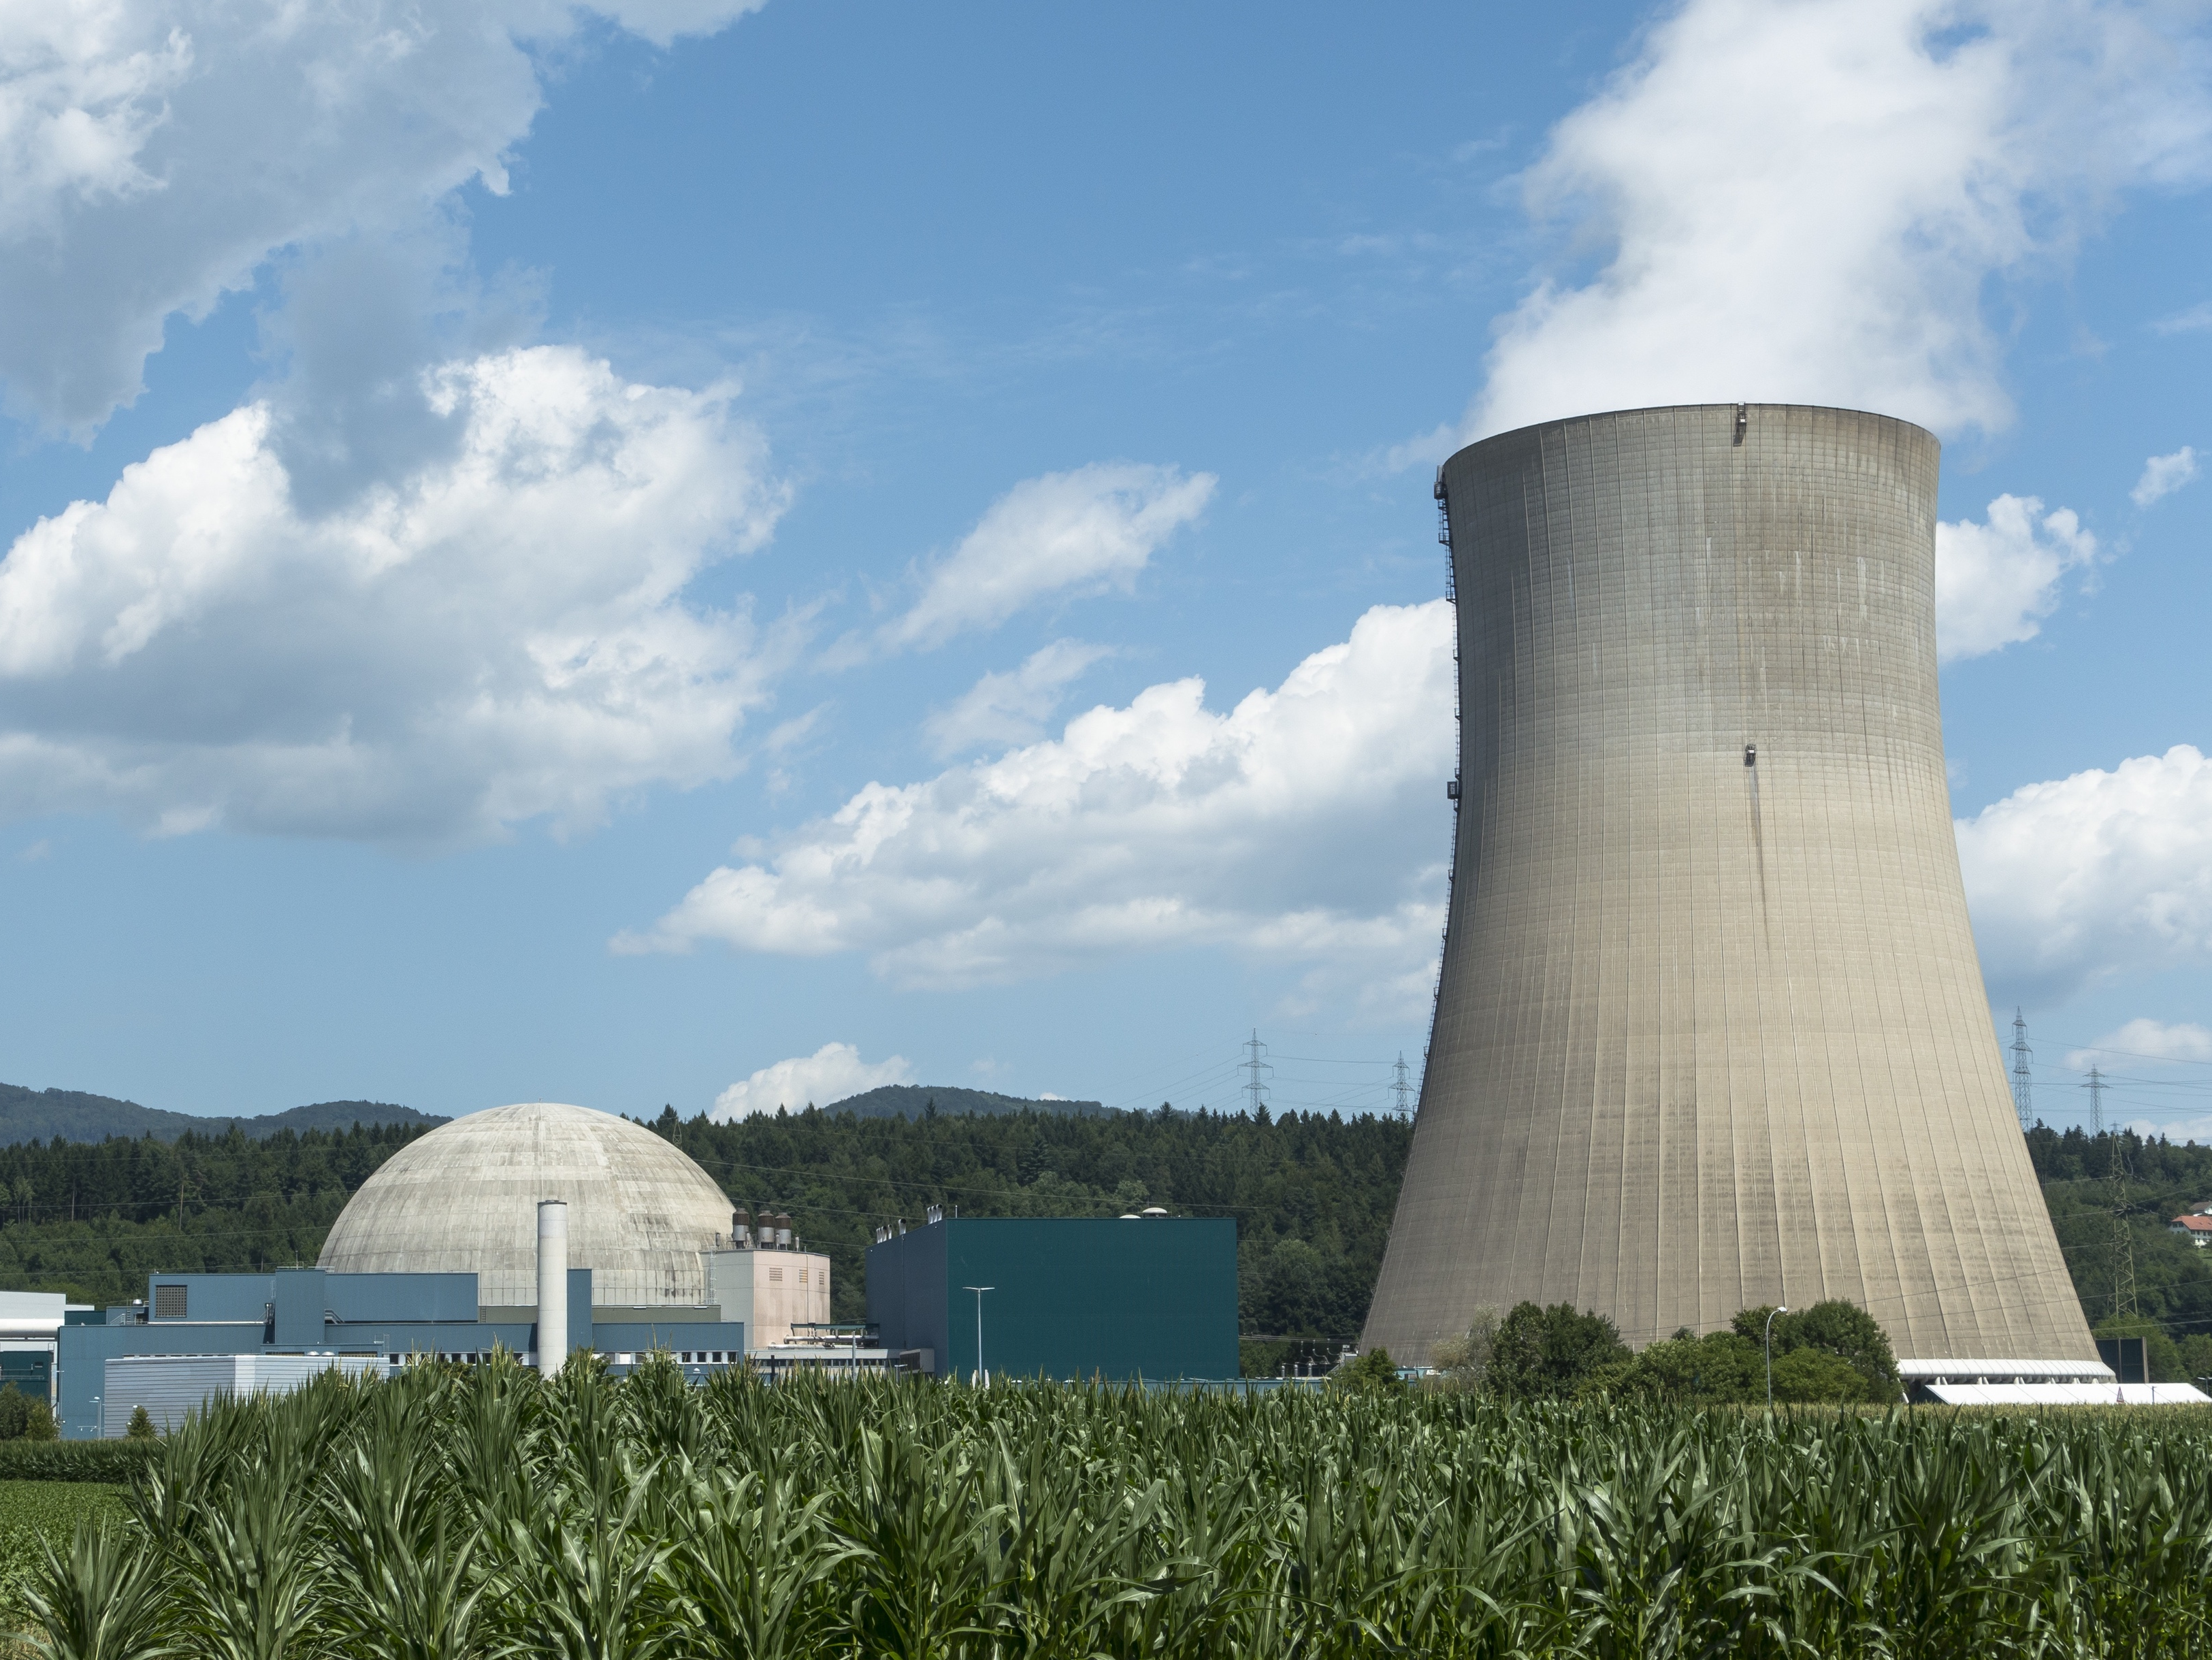
Nuclear Chemistry:
Types of Nuclear Radiation

Slide 2
Unstable Atoms
Unstable atoms emit excess energy from their nuclei to become more stable. The energy and particles released are called nuclear radiation.
+
+
Unstable Nucleus
Stable Nucleus
Particles
Energy
Radiation

Slide 3


Types of Radiation
Alpha Particles: Identical to a helium nuclei.
4
2
He
Beta Particles:
Electrons emitted as radiation.
0
-1
e
γ
γ
Gamma Rays:
Emitted as a wave, not a particle.
0 0

Slide 4
Alpha Particles
Largest of the nuclear radiation particles.
Because of the size, has the least penetrating power. Can be stopped by paper or skin.
Least dangerous form of radiation.
4
2
He

Slide 5
Beta Particles
Smaller particles. Can penetrate skin.
Can be stopped by metal or wood.
γ
Gamma Rays
No mass and high penetrating power.
Extremely dangerous. Can be stopped by thick layers of concrete.

Slide 6
Strength of Radiation
Alpha Radiation
Beta Radiation
Gamma Rays
Sheet of Paper
Sheet of Aluminum
Thick Concrete Wall

Slide 7
Alpha Decay
238
92
U
234
90
Th
4
2
+
He
Unstable Nucleus
Stable Nucleus
Alpha Particle

Slide 8
Beta Decay
14
6
C
14
7
C
+
0
-1
e
Unstable Nucleus
Stable Nucleus
Beta Particle

Slide 9
Gamma Decay
Tc
γ
99
43
Tc*
99 43
+
0
0
Unstable Nucleus
Stable Nucleus
Gamma Ray

Slide 10
Uses of Radiation
Cancer Treatment:
Radiation is used to destroy cancer cells.
Nuclear Medicine: Radioactive substances can be inserted into the body to view internal organs.
Food Irradiation: Radiation can be used to reduce or eliminate bacteria on food.

Slide 11
Nuclear Chemistry:
Types of Nuclear Radiation

Slide 12
Unstable Atoms
Unstable atoms emit excess energy from their nuclei to become more stable. The energy and particles released are called .
+
+
Unstable Nucleus
Stable Nucleus
Particles
Energy
Radiation

Slide 13
Types of Radiation
Particles: Identical to a helium nuclei.
4
2
He
Particles:
Electrons emitted as radiation.
0
-1
e
γ
γ
Rays:
Emitted as a wave, not a particle.
0 0

Slide 14
Alpha Particles
Largest of the nuclear radiation particles.
Because of the size, has the least penetrating power. Can be stopped by paper or skin.
dangerous form of radiation.
4
2
He

Slide 15
Beta Particles
Smaller particles. Can penetrate skin.
Can be stopped by metal or wood.
γ
Gamma Rays
No mass and high penetrating power.
Extremely dangerous. Can be stopped by thick layers of concrete.

Slide 16
Strength of Radiation
Sheet of Paper
Sheet of Aluminum
Thick Concrete Wall

Slide 17
Alpha Decay
238
92
U
234
90
Th
4
2
+
He

Slide 18
Beta Decay
14
6
C
14
7
C
+
0
-1
e

Slide 19
Gamma Decay
Tc
γ
99
43
Tc*
99 43
+
0
0

Slide 20
Uses of Radiation
Cancer Treatment:
Radiation is used to destroy cancer cells.
Nuclear Medicine: Radioactive substances can be inserted into the body to view internal organs.
Food Irradiation: Radiation can be used to reduce or eliminate bacteria on food.

